Slide 1
Presenter : Urvi Pasad Module : Term 1 and Term 2 EDA Project
Batch : October 19 Cohort
EDA on Crime Rates in Boston City

Slide 2
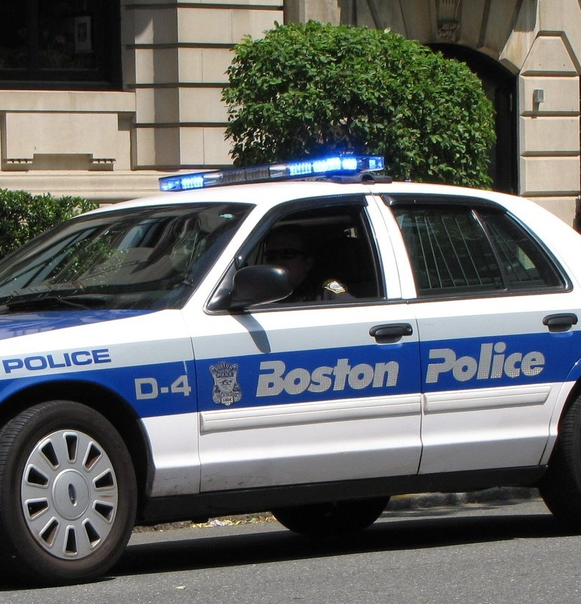
Overview : EDA on Crime Rates in Boston City
Data is collected from this site. https://data.boston.gov/dataset/crime-incident-reports-august-2015-to-date-source-new-system
Records are from year 15th June 2015 to 13th October 2019.
Crime incident reports are provided by Boston Police Department (BPD) to document the initial details surrounding an incident to which BPD officers respond. This is a dataset containing records from the new crime incident report system, which includes a reduced set of fields focused on capturing the type of incident as well as when and where it occurred.

Slide 3
Problem Statement
What are most common types of crimes?
Which areas are prone to the different types of crimes to occur?
What is the pattern and likelihood of the crimes and How the Crime frequency changes over the day? Week? Year?

Slide 4
Overview of EDA Approach
High level Analysis of the crimes in Boston.
1
Understand the trend of the most frequent Crimes in Boston under each UCR Part category
2
Understand Year wise, Day Wise or Hour wise trend and pattern of the crimes
3

Slide 5
High level Analysis of the crimes in Boston.
1

Slide 6
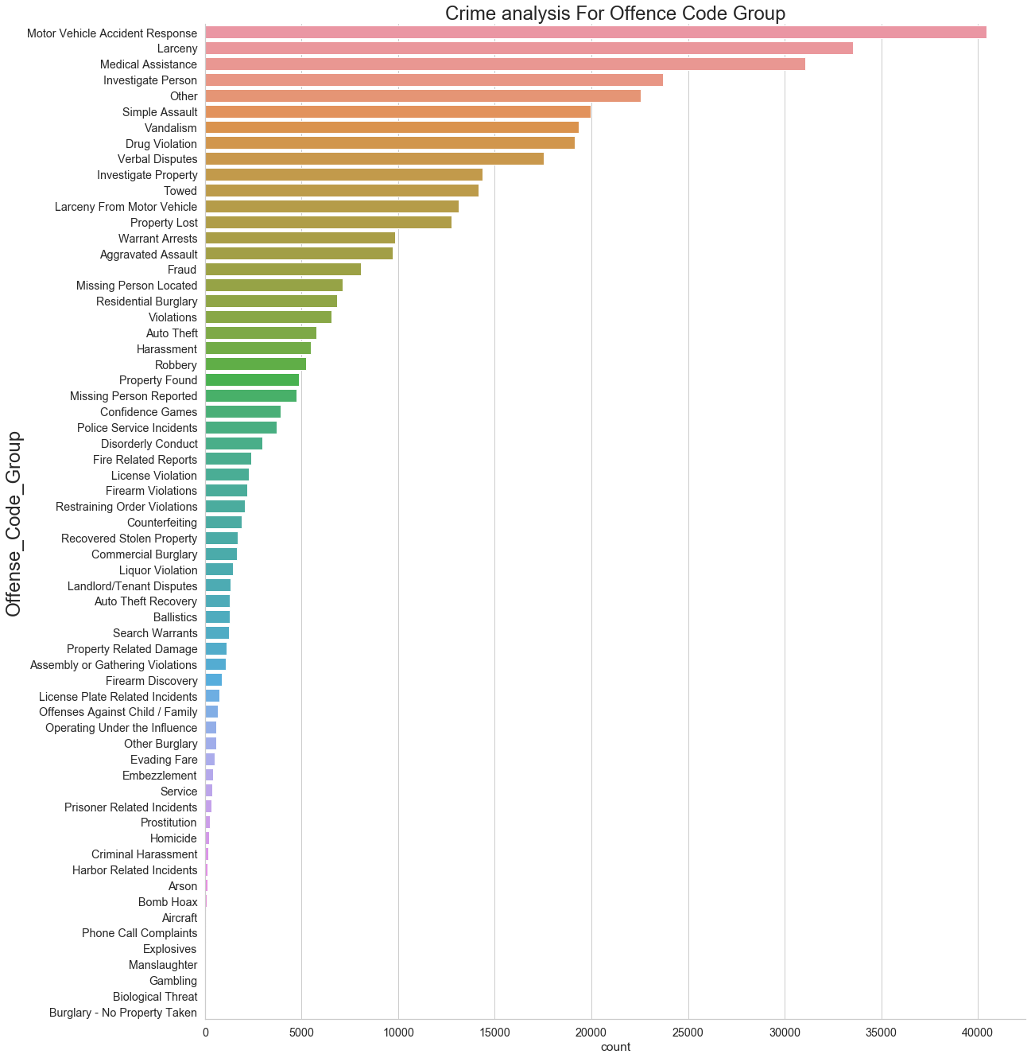
Motor Vehicle Accident Response and Larceny are the most frequent offence in Boston

Slide 7
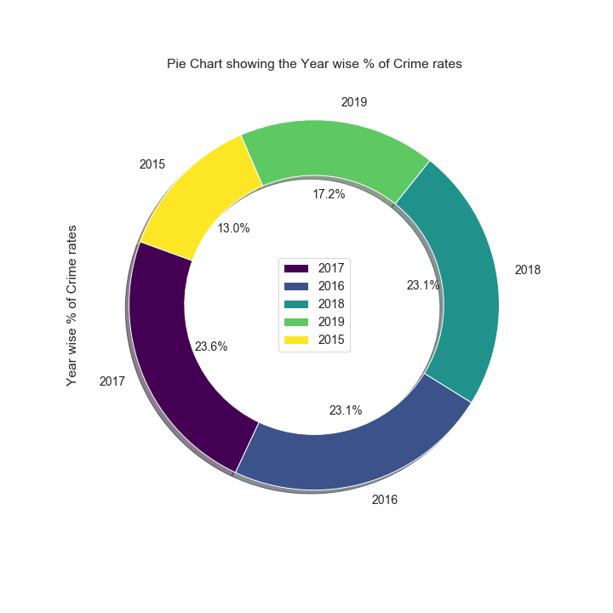
In year 2017 Boston has the highest crime rates which is 23.6 % as compared to 2016 and 2018
Notes:
Notes: For year 2015 and 2019 since we do not have complete year crime details we will ignore it for this EDA.

Slide 8
Understand the trend of the most frequent Crimes in Boston under each UCR Part category
1
2

Slide 9
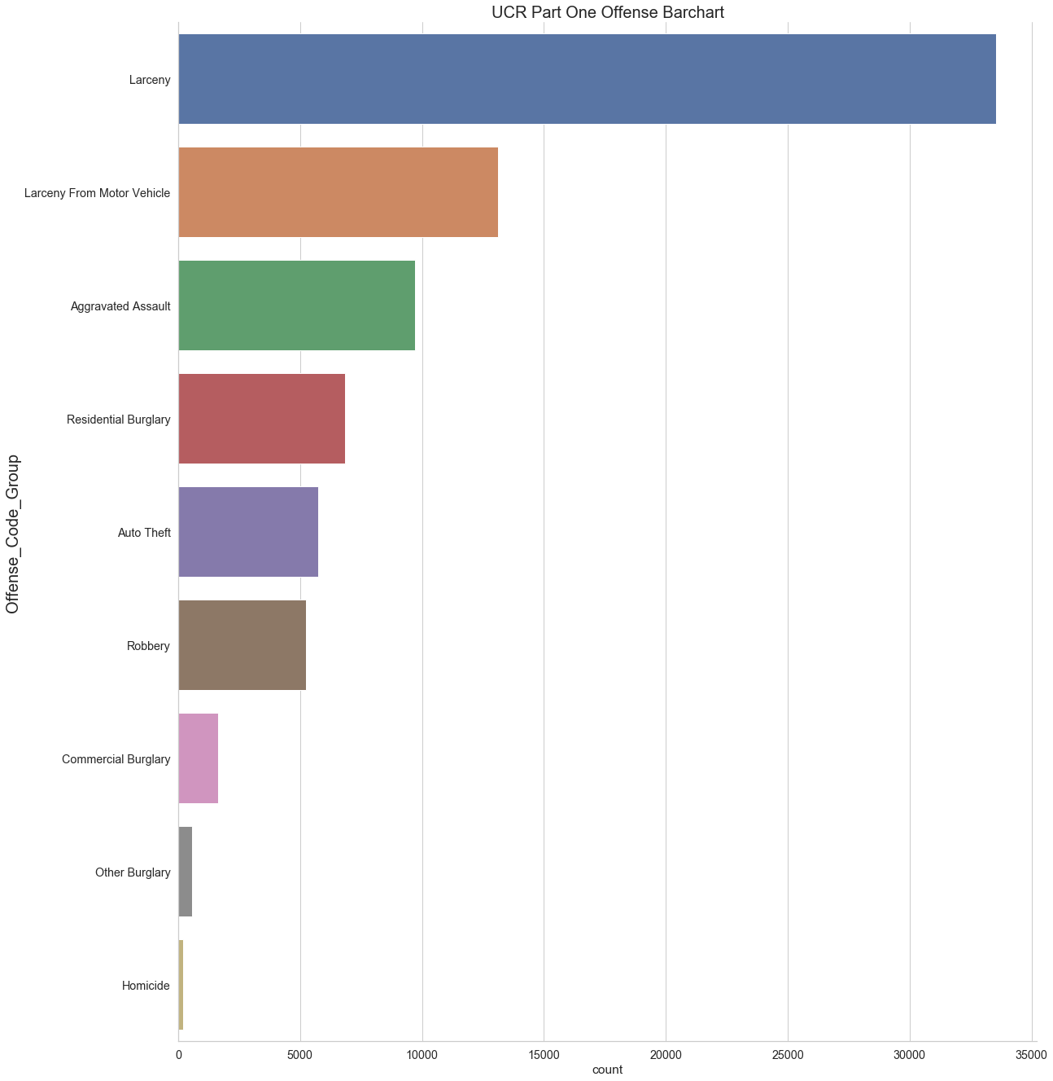
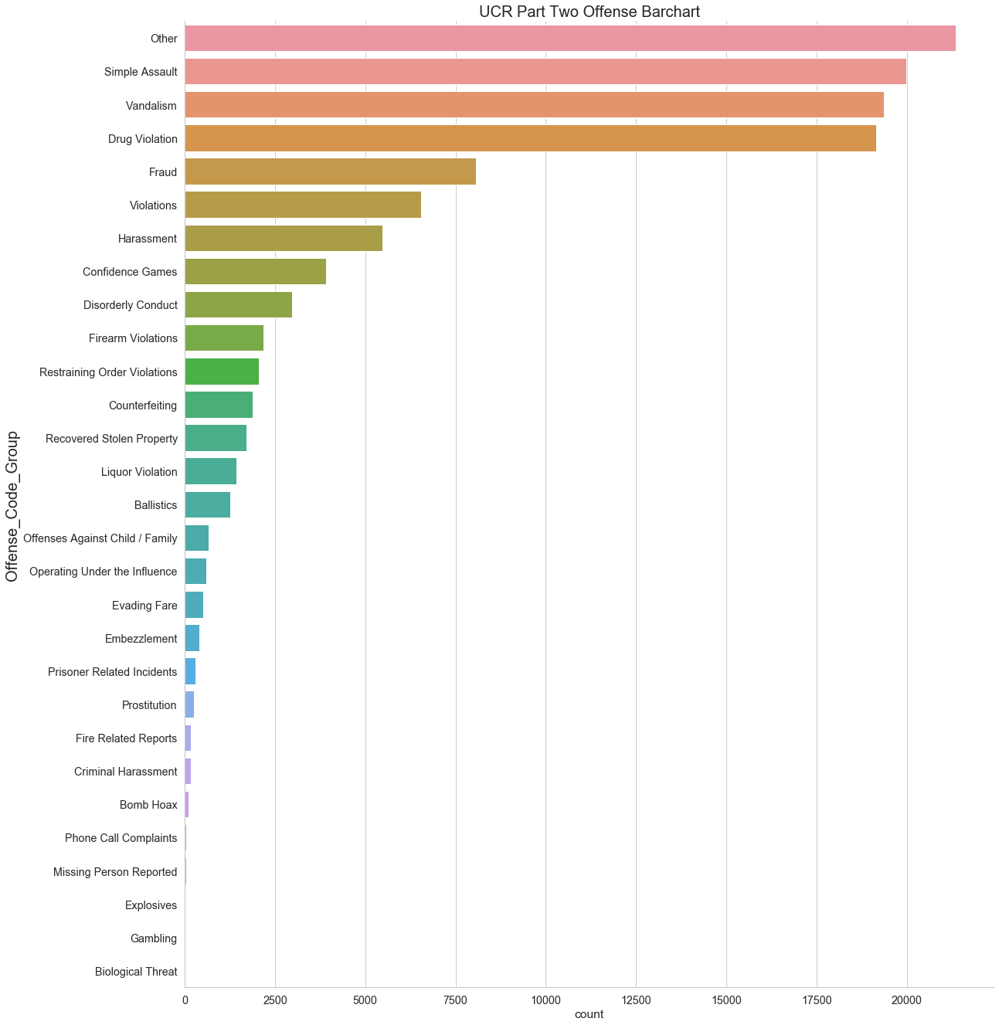
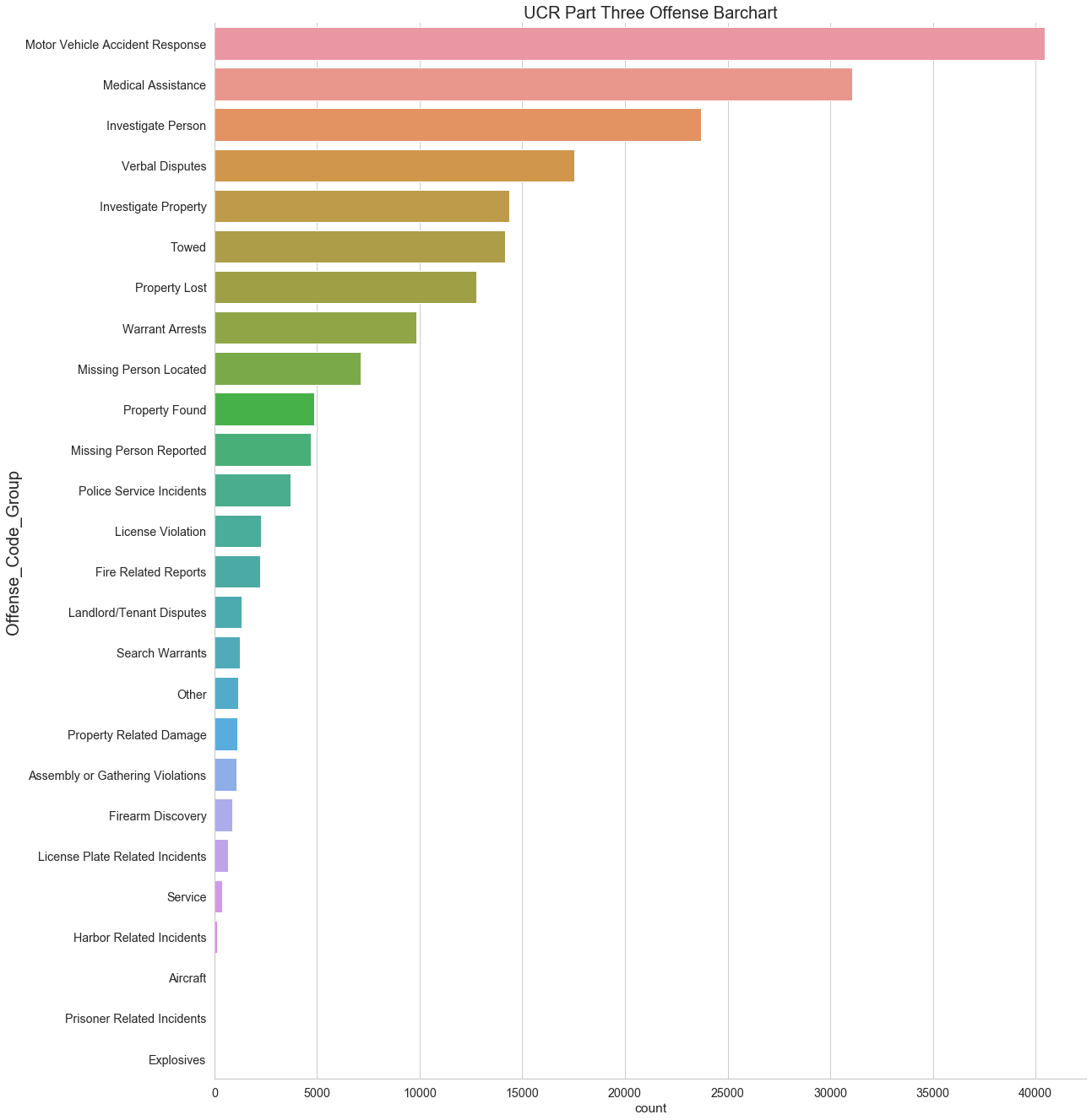
Frequency of Offenses under Each UCR Category
Larceny is most frequent crime under Part One UCR category crimes
Simple Assault, Vandalism is most frequent crime under Part Two UCR category crimes.
Motor Vehicle Accident Response is most frequent crime under Part Three UCR category crimes

Slide 10
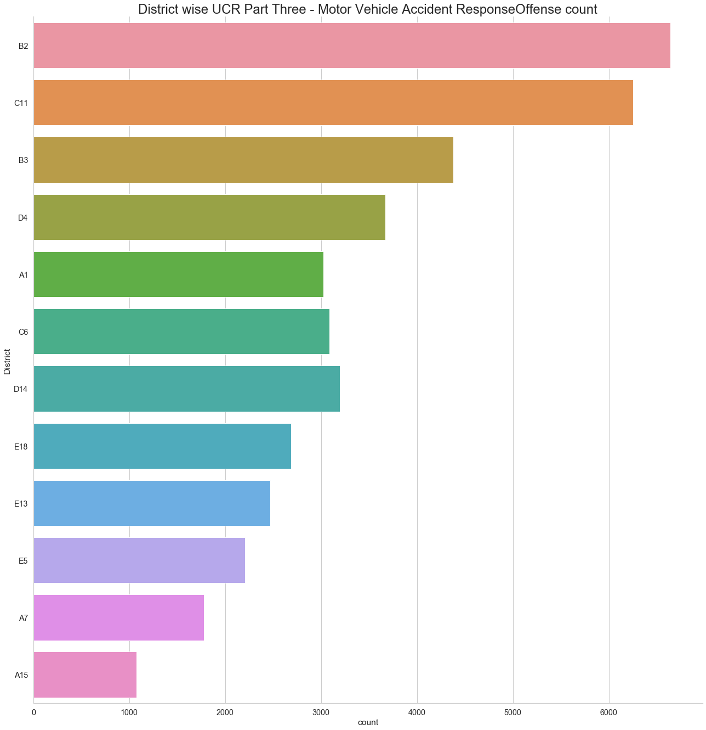
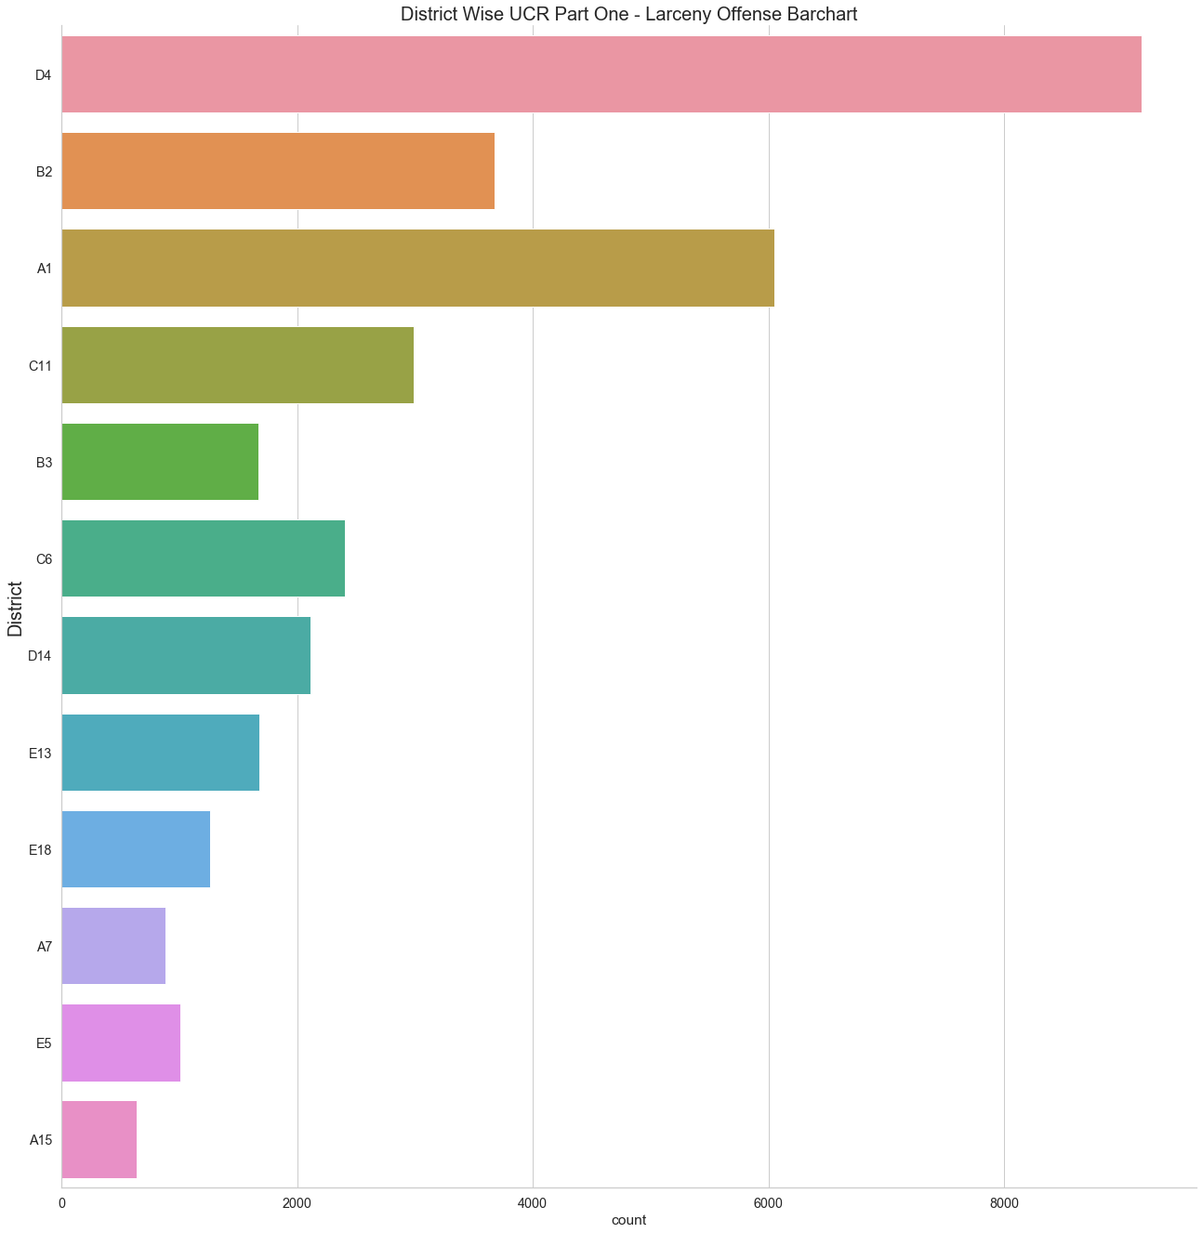
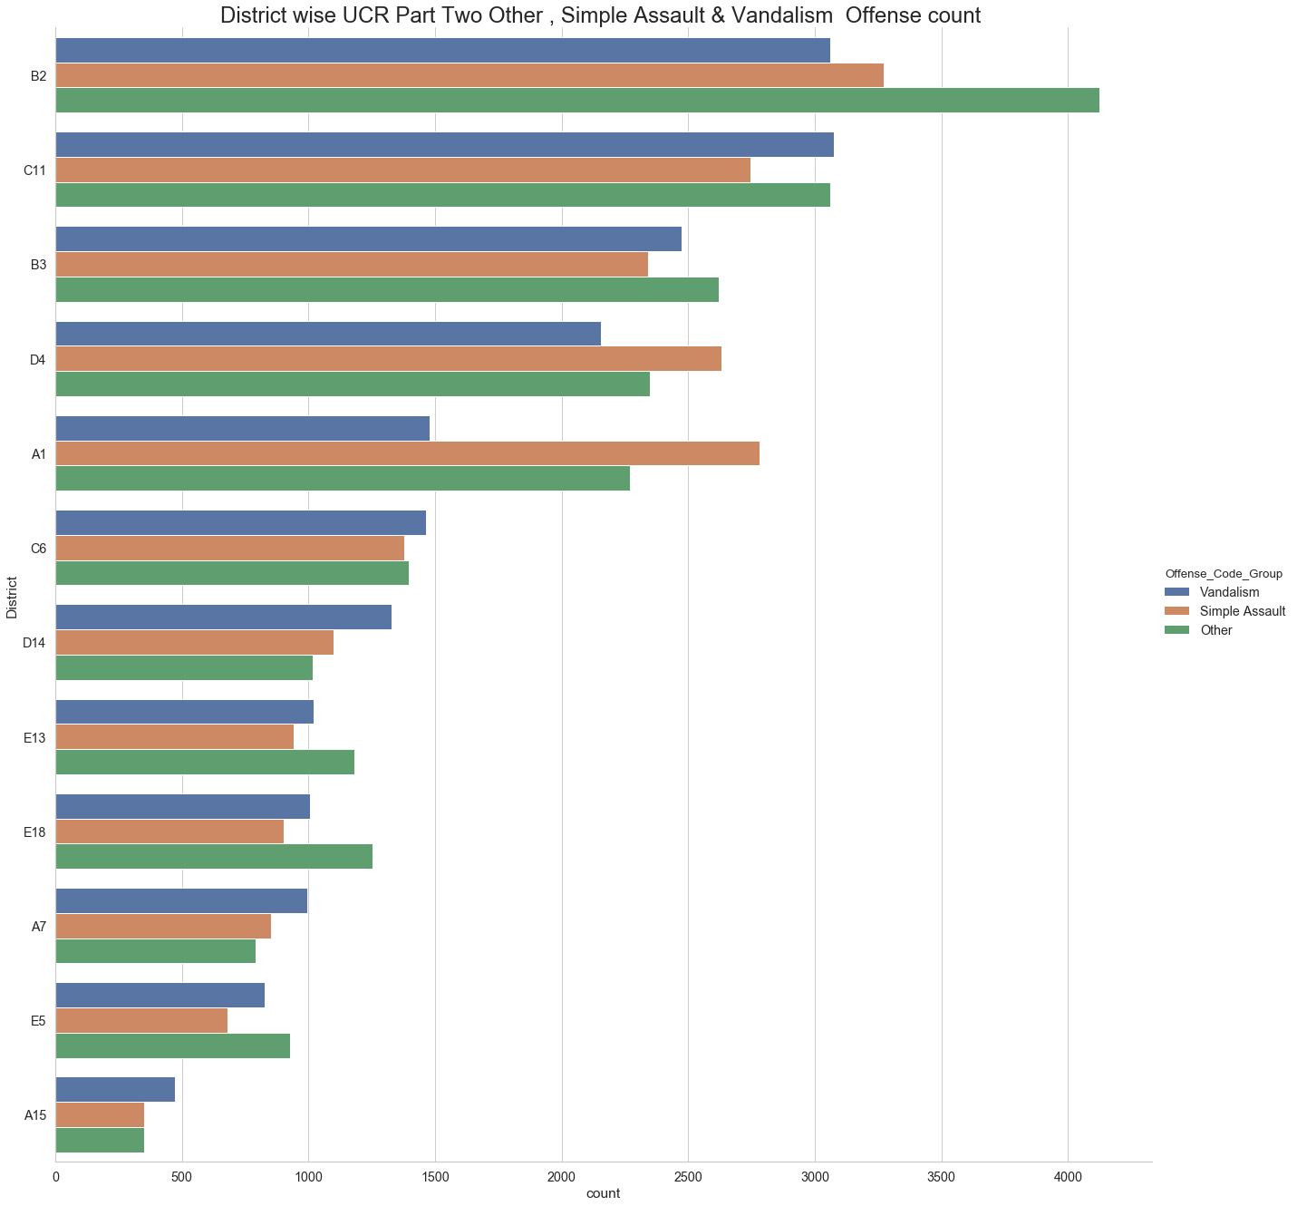
Compare UCR Part Category Crimes District Wise
Larceny is most frequent crime under Part One UCR category crimes and in D4 District Larceny crime count is quite high compared to A1 and B2.
Simple Assault, Vandalism is most frequent crime under Part Two UCR category crimes. And it is high in B2 and C11 district
Motor Vehicle Accident Response is most frequent crime under Part Three UCR category crimes and It is high in B2 and C11 district

Slide 11
Understand Year wise, Day Wise or Hour wise trend and pattern of the crimes
1
3

Slide 12
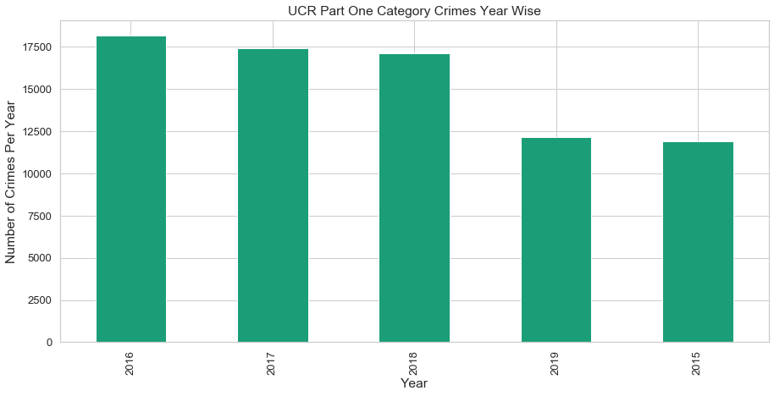
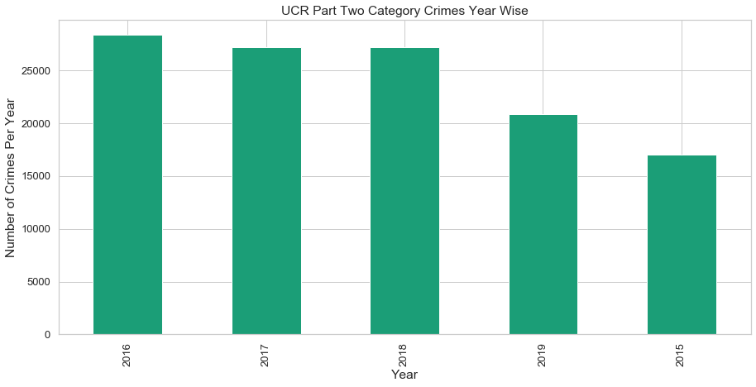
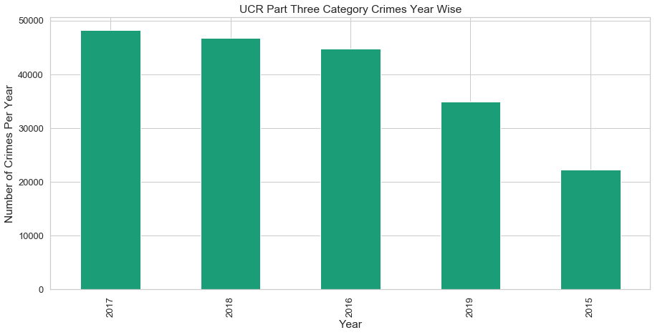
Compare UCR Part Category Crimes - Year Wise
Year 2016 the UCR Part One & Two Crime rate is slightly above as compared to year 2017 & 2018
In year 2017 UCR Part Three crime rate is high as compared to other two category crimes

Slide 13
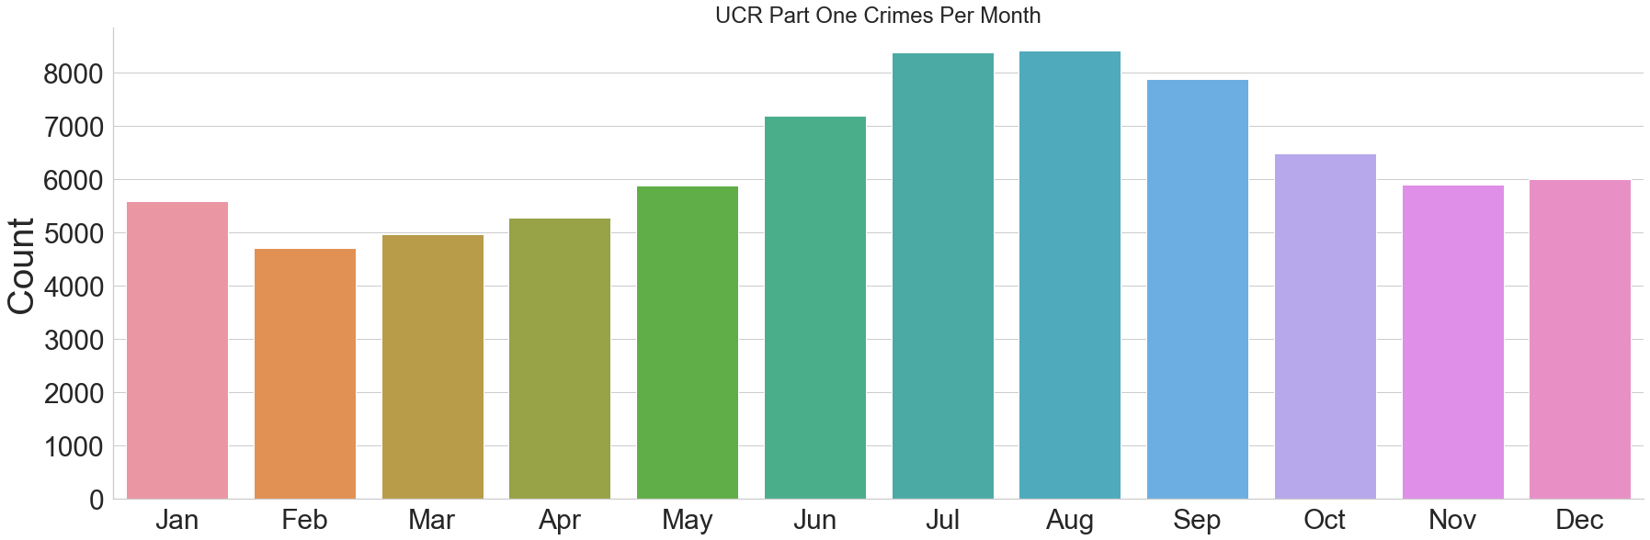
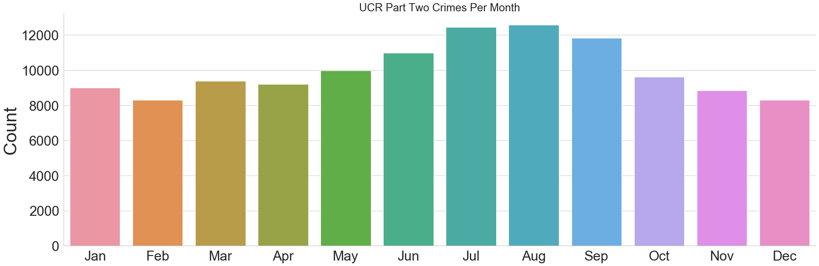
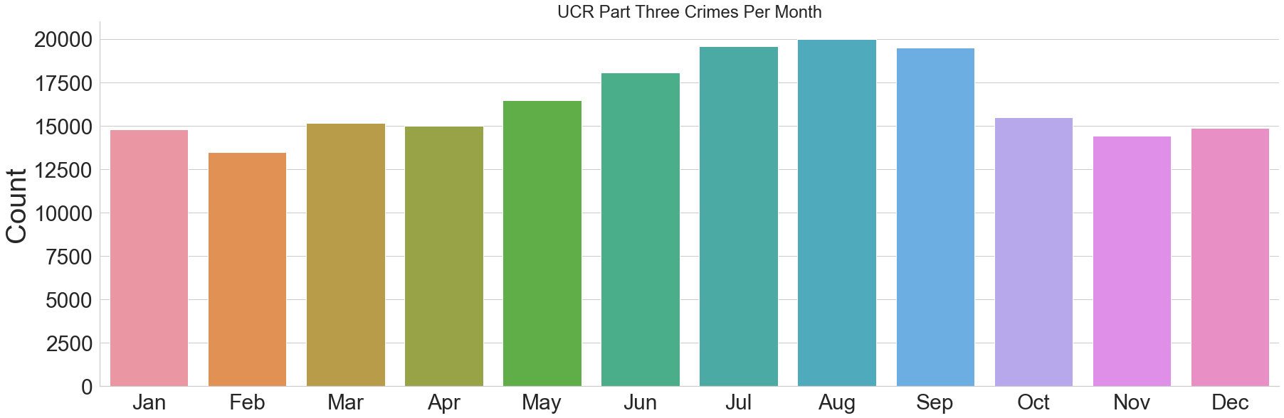
Compare UCR Part Category Crimes - Month Wise
The month also seems to have some influence, with the winter months of February - May having the lowest crime rates, and the summer/early fall months of June -October having the highest crime rates.
This pattern is observed for all three UCR Category crimes

Slide 14
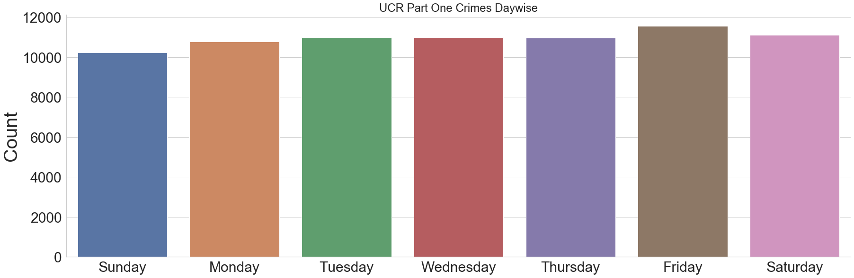
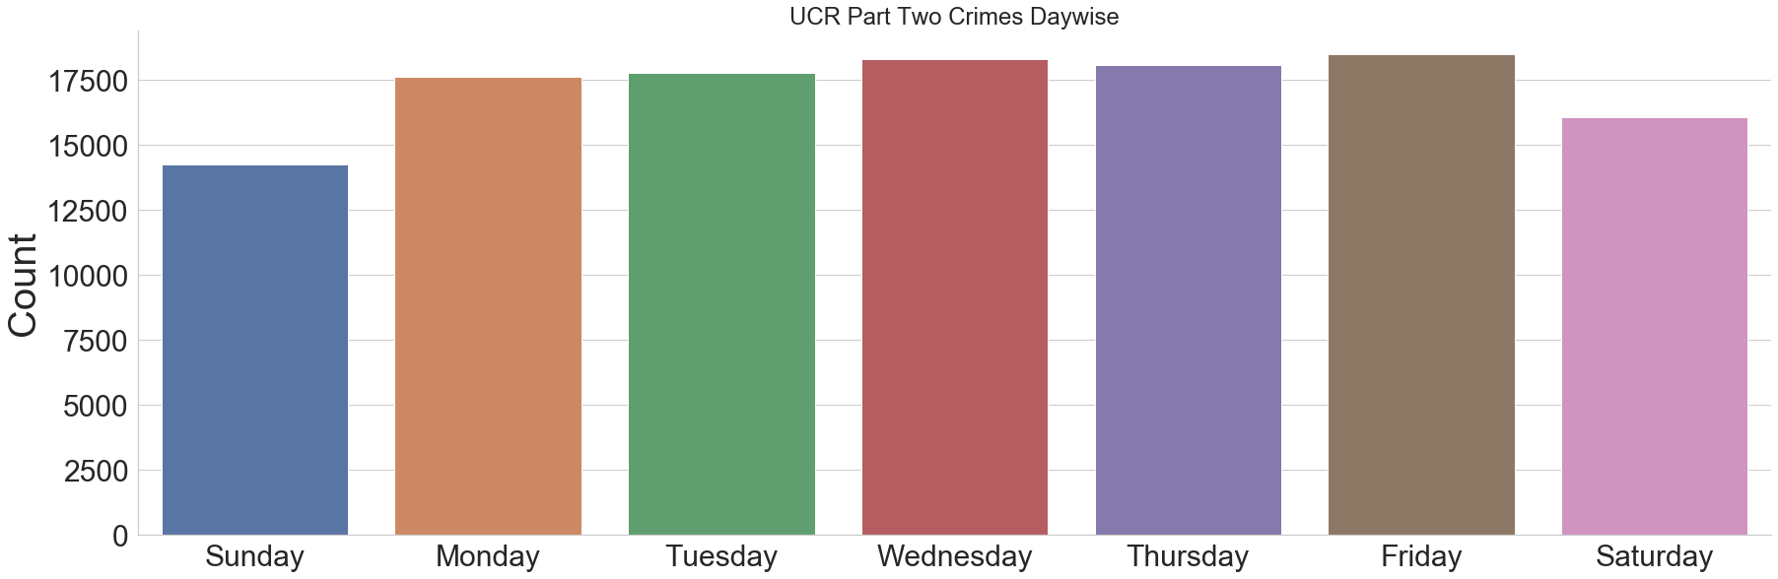
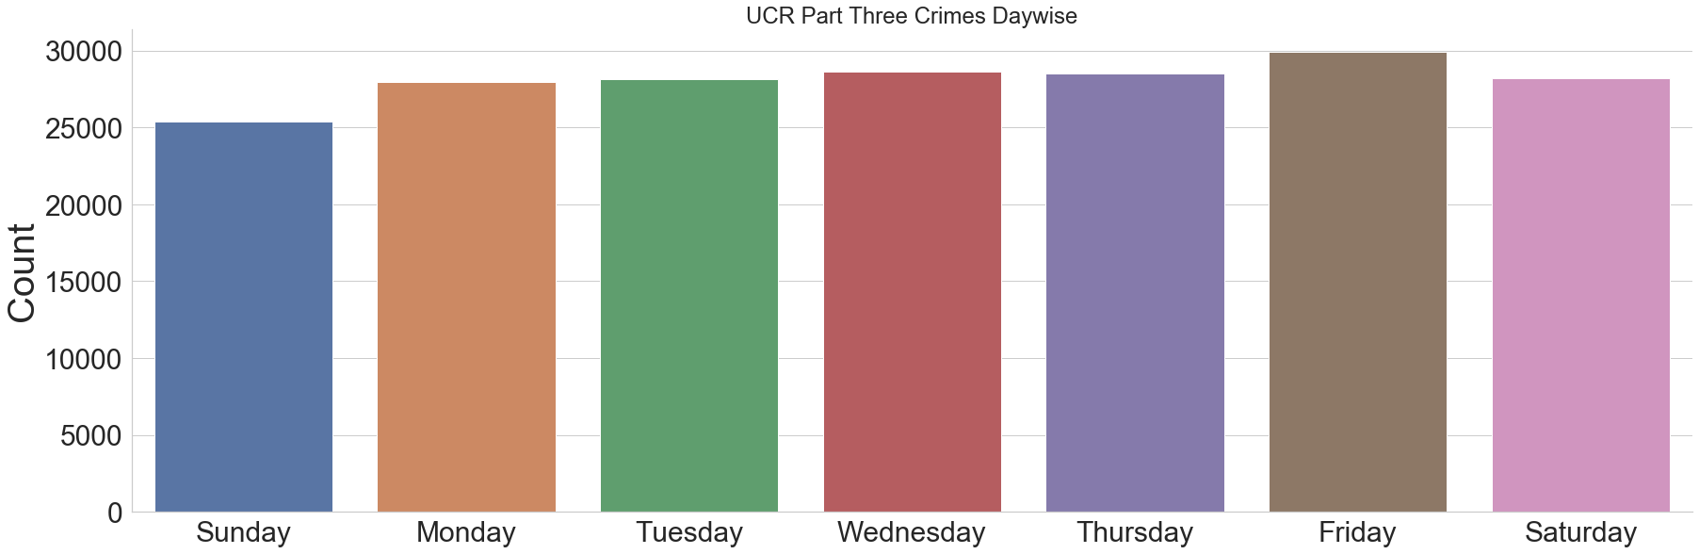
Compare UCR Part Category Crimes - Day Wise
There is some variation across days of the week, with Friday having the highest crime rate and Sunday having the lowest for all three UCR Category crimes.

Slide 15
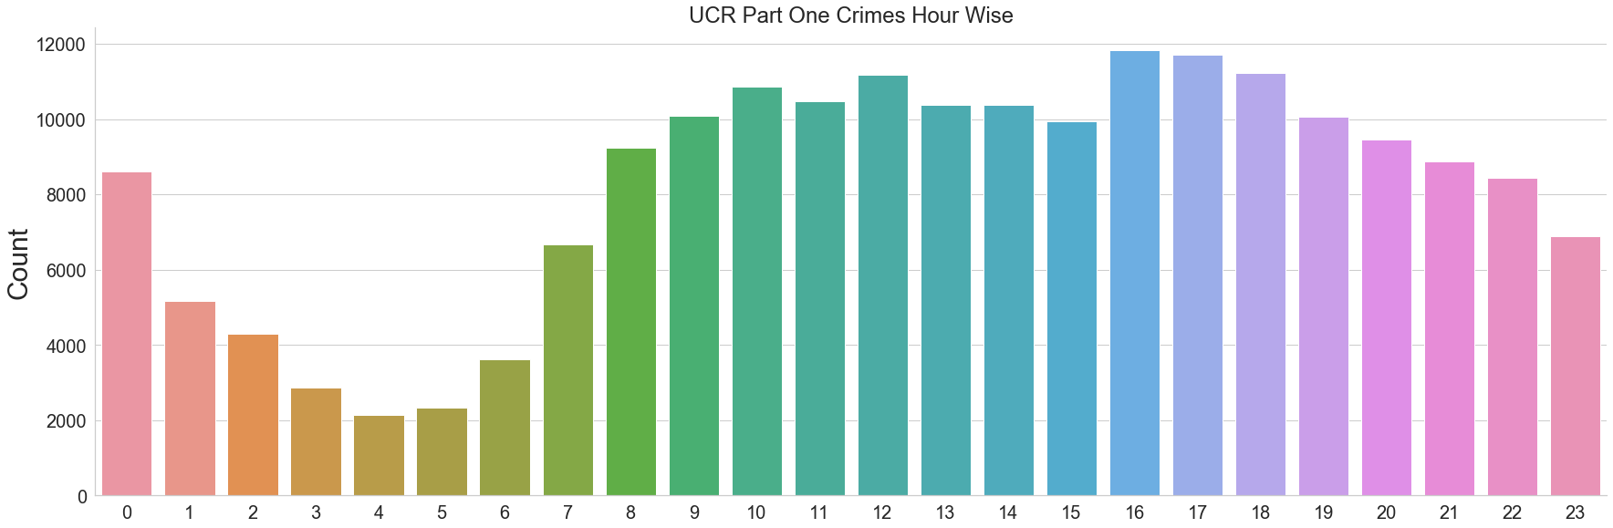
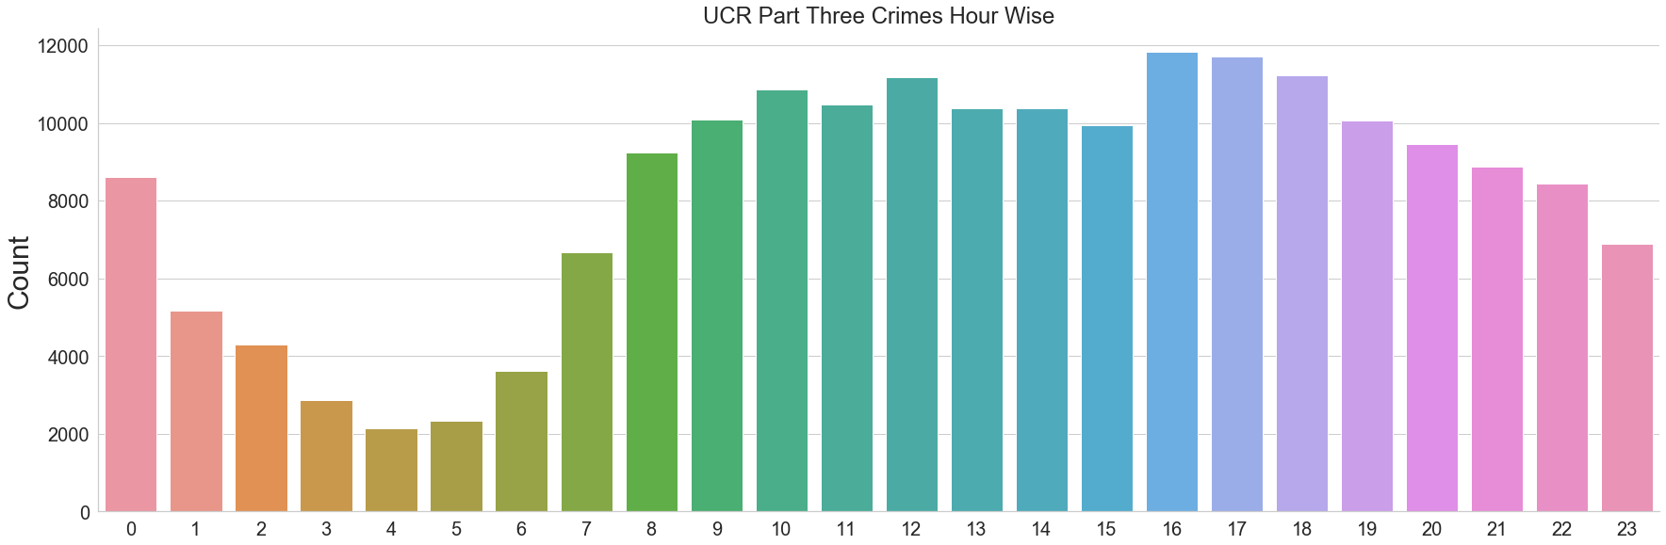
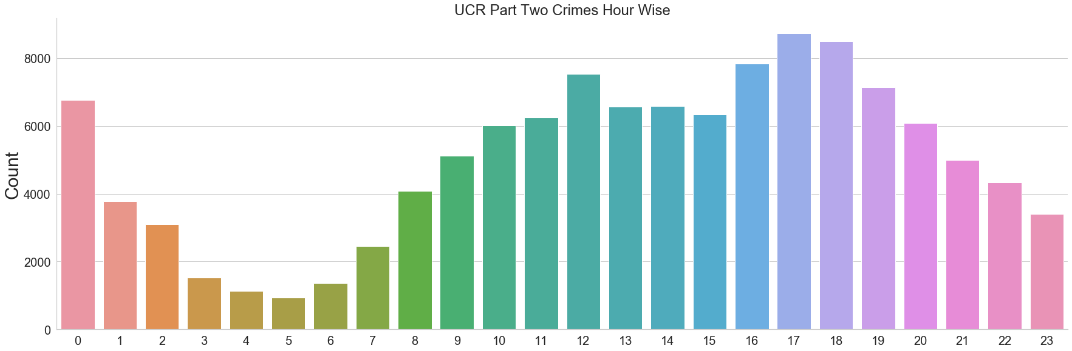
Compare UCR Part Category Crimes - Hour Wise
All three types of UCR Category Crimes rates are low between 1-8 in the morning, and gradually rise throughout the day. Crime rate is at peak time during evening which is between 4 pm - 7Pm

Slide 16
Conclusion
In Boston, mainly three types of UCR part crimes are reported.
Part Three crimes are 49.8% in Boston whereas the most Serious Part One Crime is 19.4% from the year 2015 to 2019
Motor Vehicle Accident Reponse and Larceny are the most frequent offense in Boston
Overall year 2017 has the highest crime rates which is 23.6% as compared to 2016 and 2018.
Winter months of February-April having the lowest crime rates, and the summer/early fall months of June-October having the highest crime rates.
Friday having the highest crime rate and Sunday having the lowest.
Crime rates are low in the morning, and gradually rise throughout the day. Crime rate is at peak during the evening which is between 4 pm - 7Pm .
B2, C11 and D4 district have high crime rates in Boston

Slide 17

Thank You

